Slide 1
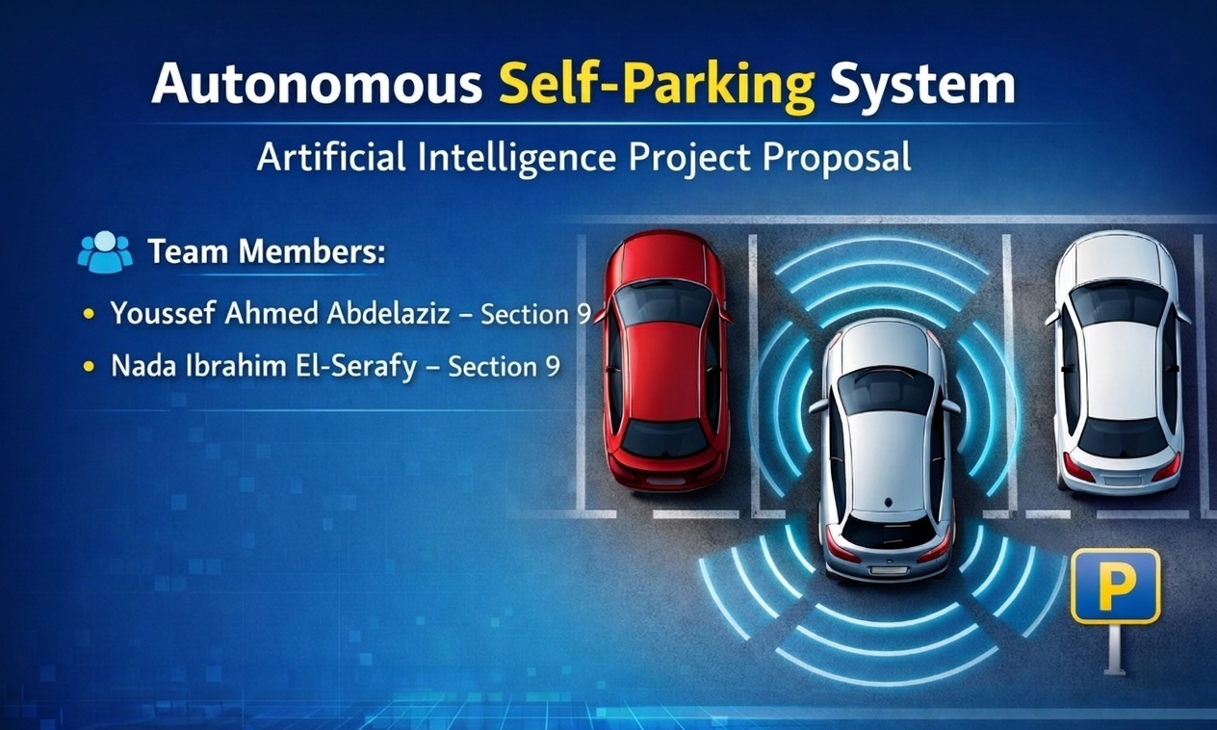

Slide 2
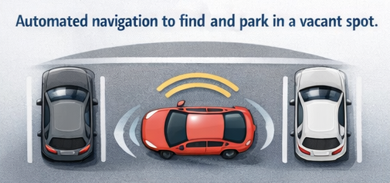
1. Project description
The Autonomous Self-Parking System is an intelligent agent designed to navigate a vehicle from a starting point within a parking lot to a designated vacant spot.
The system must maneuver the vehicle safely, avoiding obstacles (other cars, curbs, or pedestrians), and align the vehicle perfectly within the parking boundaries without human intervention.

Slide 3
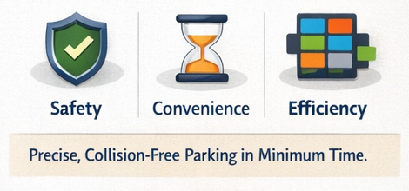
2. Goal and Importance
Goal:
To achieve precise, collision-free parking in the shortest time possible using optimized path-finding algorithms.
Importance:
• Safety: Reduces minor accidents and scratches caused by human error in tight spaces.
• Convenience: Saves time for drivers and assists those who find parallel or reverse parking difficult.
• Efficiency: Optimizes the use of available parking space.

Slide 4
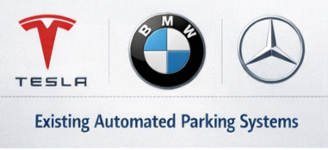
3. Related Work
Automated parking assistance systems are widely used in modern vehicles. Many automotive companies such as Tesla, BMW, and Mercedes-Benz have introduced technologies that allow cars to automatically detect and park in available spaces.
In academic research, similar problems are studied under path planning and autonomous navigation. These systems typically represent environments as graphs or grids and apply search algorithms to determine optimal routes.

Slide 5
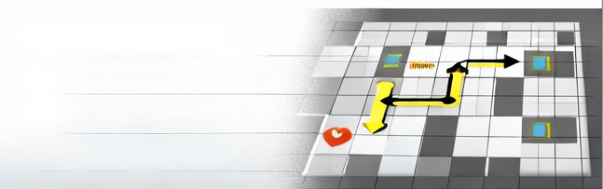

4. Proposed Algorithm
The system will use a classical Artificial Intelligence search algorithm called A* (A-Star). This algorithm is commonly used in pathfinding and navigation problems.
The parking lot will be represented as a grid. Each cell represents a possible position for the vehicle. Obstacles such as parked cars will be treated as blocked cells that cannot be crossed.
A* works by evaluating possible paths using a cost function that combines the actual distance traveled and a heuristic estimate of the remaining distance to the goal. In this project, the heuristic function may use Manhattan Distance to estimate how far the vehicle is from the target parking space.
$$f\left(n\right)=g\left(n\right)+h\left(n\right)$$

Slide 6
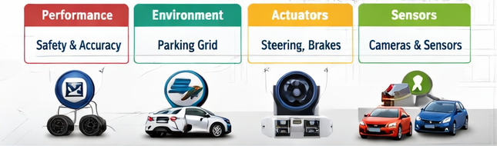
5. PEAS Analysis
Component | Description
Performance Measure | Safety (zero collisions), accuracy of alignment, time efficiency, and minimal maneuvers.
Environment | Parking lot represented as a grid containing free spaces, obstacles, and parking slots.
Actuators | Steering wheel motor, accelerator, brakes, and gear shifter (Forward/Reverse).
Sensors | Ultrasonic sensors (for distance), Cameras (for line detection), and Odometry (to track wheel rotation/position).

Slide 7

6. Environment Characteristics (ODESA)
O - Partially Observable: The agent cannot see the entire parking lot at once; it only perceives what its sensors detect within a specific range.
D - Stochastic: The environment is not 100% predictable. Other cars might move or pedestrians might cross unexpectedly.
E - Sequential: Every movement (turning the wheel) affects the next state and position of the car.
S - Dynamic: The environment changes (moving objects) while the agent is deliberating or moving.
A - Single/Multi-Agent: Usually Single Agent (focusing on one car's logic), but can be Multi-Agent if other smart cars are interacting in the same space.

Slide 8
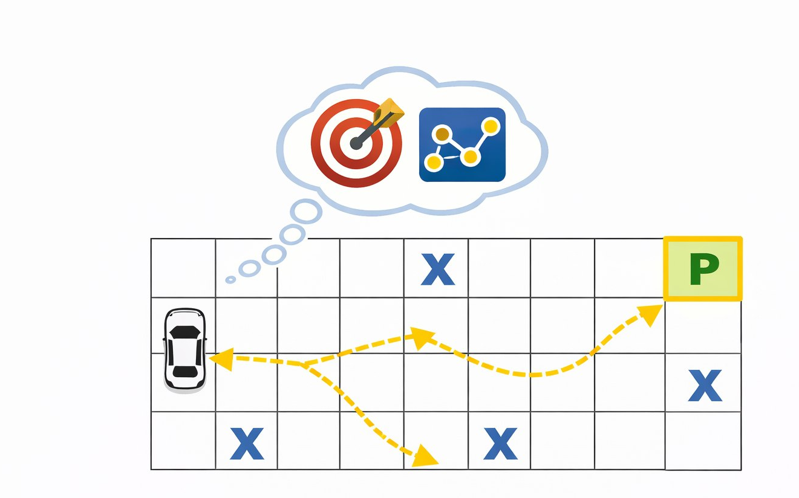
7. Agent type
The Agent Type is: Goal-Based Agent .Reasoning :The agent has a specific Goal (to be parked correctly in the spot). It doesn't just react to the current moment (like a simple reflex agent), but it plans a sequence of actions (pathfinding) and evaluates different moves to reach the final desired state (the target parking spot

